Slide 1
국제인증 유기농화장품, 환경 친화적 생활용품 제조 전문기업
Specialized in manufacturing certified organic cosmetics, eco-friendly household goods.

Slide 2
Contents
Company Overview
Corporate History
About CEO
Organization Chart
About CH Harmony Brand
Business Area
Competitiveness of CH Harmony
Manufacture factory
R & D Center
Certificate
Products
www.chharmony.com

Slide 3
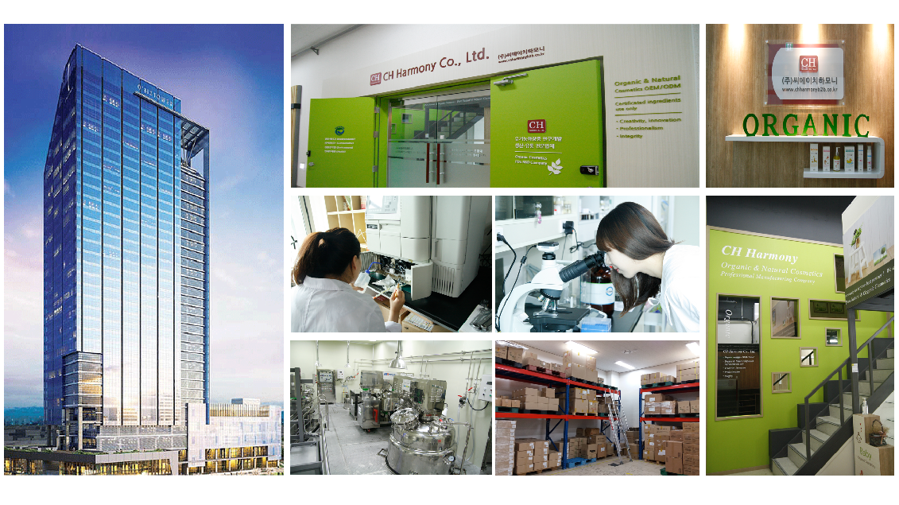
Company Overview
Date of
Establishment May 2006
Business Areas Organic & Natural Cosmetic, Eco-friendly household goods
Trading(Parchment paper, cosmetic container, and so on)
Headquarter (Pyeongchon O’Biz TOWER)222, 126, Beolmal-ro, Dongan-gu,
Anyang-si, Gyeonggi-do, Korea
Factory (Pyeongchon O’Biz TOWER)222, 126, Beolmal-ro, Dongan-gu,
Anyang-si, Gyeonggi-do, Korea
Web Site B2C : www.chharmony.co.kr
B2B : www.chharmonyb2b.co.kr
DIY : www.diyorganic.co.kr
Company : www.chharmony.com
Contact chsale01@chharmony.co.kr
Tel +82 70 8670 1978
Fax +82 31 476 2666
www.chharmony.com

Slide 4
Corporate History
■Major Corporate Milestones
2020
05 Certificate as an excellent company in labour safety and health in Gyeonggi-do in 2020
2019
12 Awarded Excellent Venture Company in Kyoung-gi Prv.(Ministry of SMEs and Startups)
Awarded 26th Enterprise Innovation Awards (Korea Chamber of Commerce and Industry)
08 2019 Korea Organic Star Products Competition Gold Award (Ministry of Agriculture, Food and Rural Affairs)
03 Granted a patent(10-1965178) : Methods of manufacture of undiluted extract of hot vacuum extraction method
and the undiluted extract manufactured by it
2018
Certified Kyoung-gi prv. Promising Small and Medium-sized Enterprises (No.2018-116)
12 Commendation for commercialization of excellent agricultural technology(Rural Development Administration)
04 USDA-NOP Certified
2017
09 CHOBS 24sku Registered CPNP(Europe)
06 CHOBS 24sku HALAL(ESMA, UAE)
04 Commendation for Regulatory Reform (President)
2016
11 BDIH Cosmos Organic / Natural Certified
10 Vegan Society Certified
03 ISO 22716 Certified
2015
12 Award of “Environmental protection contribution”
08 Built Cosmetic factory according to CGMP
08 Granted a patent(10-1547190) : Nano liquid crystal carrier comprising sap of Acer mono
and manufacturing method thereof
01 Granted a patent(10-1482616) : Composition for hair color having an
extract of Liquat and hair color manufactured by the same
2014
05 Awarded Republic of Korea Consumer culture award [Eco-Friendly Part]
01 Won the production work on the Rules about standard of Jeju Techno Park
Organic Cosmetic Enactment bulletin guide
2013
09 Established CH Harmony Co., Ltd. Enterprise institute
06 Converted into Ch Harmony Co., Ltd.
01 Contracted MOU with Wan do-Bipa Well-being Group
www.chharmony.com

Slide 5
Corporate History
■Major Corporate Milestones
2012
10 Awarded Green product of 2012 year :
‘To the Nature Eco-Friendly scrubber’,’To the Nature Multi-use cleaner’
09 Started manufacture OEM for ORGA Whole Food Co., Ltd.(Mask Pack)
07 Started R&D of functional organic hydrogen mask pack
06 Started export ‘To the Nature Eco-friendly scrubber’ to Brazil
2011
12 Awarded the 7th Republic of Korea Environmental ceremony Eco-friendly Protection awards
11 Contracted MOU provided by KEITI,BC Card about offering green card points from environmental mark goods
10 Awarded 2011year of green product : To the Nature Eco-friendly Parchment paper
06 Started manufacturing OEM for icoop Co., Ltd (Mask Pack)
04 Started export ‘To the Nature Eco-friendly scrubber’ to Brazil
04 Registered KFDA, Cosmetics manufacturing company
03 Registered KFDA, Cosmetics manufacturing factory
2010
07 Awarded bronze prize for ‘1st organic manufacture goods show’ :
‘To the Nature Organic mask pack with rice bran’
2009
03 Winner of ‘7th Korean green-energy best company Award’-Goods section
‘To the Nature Eco-friendly parchment paper’ with biodegradable plastic saw blad
2008
Certificated Environmental mark
10 Awarded Green product of 2012 year :
‘To the Nature Eco-Friendly scrubber’,’To the Nature Multi-use cleaner’
09 Started manufacture OEM for ORGA Whole Food Co., Ltd.(Mask Pack)
07 Started R&D of functional organic hydrogen mask pack
06 Started export ‘To the Nature Eco-friendly scrubber’ to Brazil
2007
10 Start importing PARCHMENT PAPER(SLILCON COATED)
10 Registered manufacturer code of Korea’s Retail Logistics Agency
2006
05 Established CH Trading Co., Ltd.
www.chharmony.com

Slide 6
About CEO
CEO Rake Choi
■ Awards
Dec 2015 Won the “Environmental protection contribution”
May 2014 Won the Republic of Korea Consumer culture award [Eco-Friendly Part]
Sep 2012 Nominated Green product of 2012 year :
-To the Nature Eco-Friendly scrubber, To the Nature Multi-use cleaner
Dec 2011 Won the 7th Republic of Korea Environmental ceremony Eco-friendly Protection awards
Sep 2011 Nominated Green product of 2011 year
-To the Nature Eco-friendly Parchment paper
July 2010 Won the bronze prize for ‘1st organic manufacture goods show’ :
-To the Nature Organic mask pack with rice bran’
Mar 2009 Won the ‘7th Korean green-energy best company Award’-Goods section
-To the Nature Eco-friendly parchment paper’ with biodegradable plastic saw blad
www.chharmony.com

Slide 7
Organization Chart
CH Harmony
Management
Planning Division
Marketing Division
Production
Division
Logistics
Division
Quality Control
Division
R&D
Division
General Affairs
Dept.
Cosmetic Production Dept.
Warehouse
Management
Dept.
Accounting
Dept
Household goods
Production
Dept.
Distribution
Dept.
Global Marketing
Dept.
On-Line Marketing Dept.
CS Dept.
Design Dept.
www.chharmony.com

Slide 8
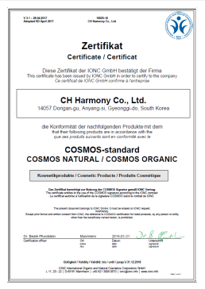
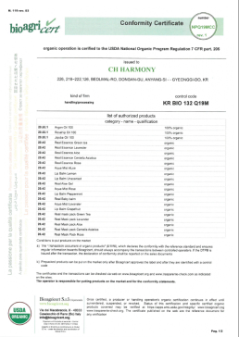
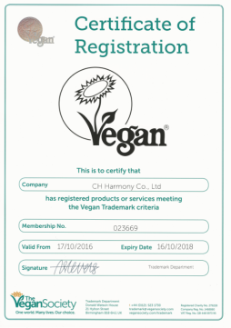
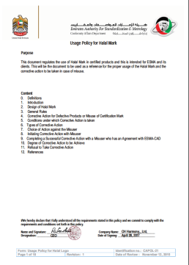
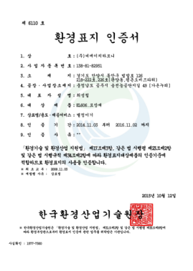
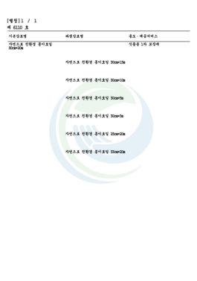
About CH Harmony Brand
Company
Organic Cosmetics
Household goods
BDIH COSMOS-ORGANIC/NATURAL
USDA-NOP
Vegan
Society
HALAL
(Esma, UAE)
Certificate of Korea Eco-Label
www.chharmony.com

Slide 9
Business Area
Main Concept
Bio-degradable in the atmosphere, soil and water in their natural state
Using natural ingredients derived from nature
Easily recyclable containers and packaging materials
Eco-friendly production methods containing our will and efforts
Evaluation of the entire process of creation and extinction of the goods on the basis of
safety and Eco-friendliness
Eco-Friendly
Trading
Distribute eco-friendly products at the on & off
line market
Researching living goods made of biodegradable plastic
Exporting ‘To the nature’ eco-friendly products
and other goods
Sourcing and importing cosmetics, health
supplement, and so on
Manufacture
Development
Manufacturing organic cosmetics
Organic cosmetics through OEM / ODM
Development of niche market through multiple channels
Research & development for the low carbon campaign
and climate change
www.chharmony.com

Slide 10
Competitiveness of CH Harmony
Company that considers not only health but also the environment
Main Concept
Bio-degradable in the atmosphere, soil and water in their natural state
Using natural ingredients derived from nature
Easily recyclable containers and packaging materials
Eco-friendly production methods containing our will and efforts
Evaluation of the entire process of creation and extinction of the goods on the
basis of safety and Eco-friendliness
◆ Standard for development, production
and handling of the products
on the basis of nature.
www.chharmony.com

Slide 11
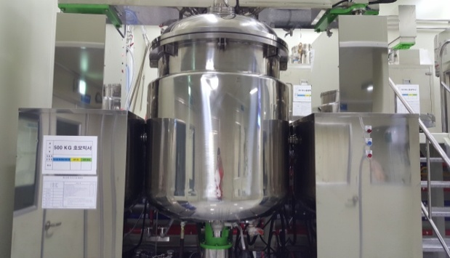
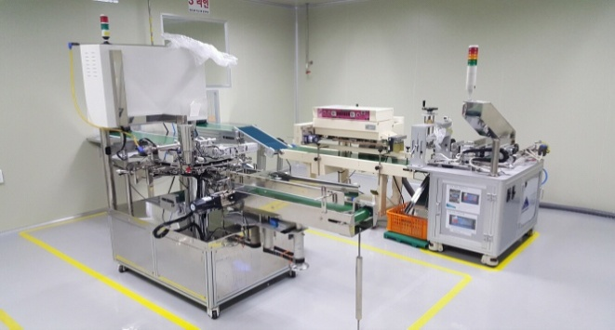
Manufacture factory
◆ Factory Introduction
■ Company specializing in R&D, Manufacturing pure nature & organic cosmetics
■ The facility confirmed to CGMP(ISO 22716)
◆ Factory Information (C Cosmetics manufacturers :20433)
◆ Production Equipment
■ Factory site area ■ Manufacturing facility area
■ Additional facilities area ■ Factory construction area
■ Main item : Organic cosmetics ■ Main raw materials : Organic raw materials
www.chharmony.com

Slide 12
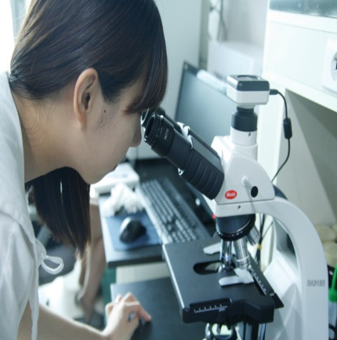
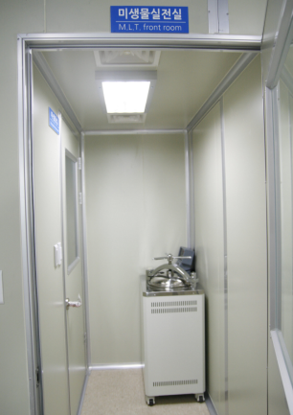
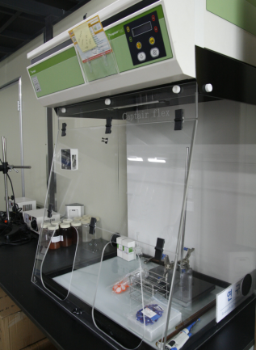
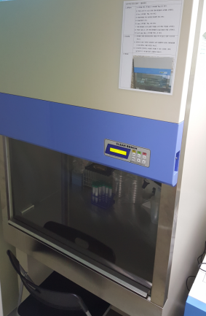
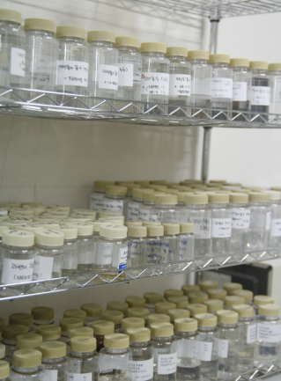
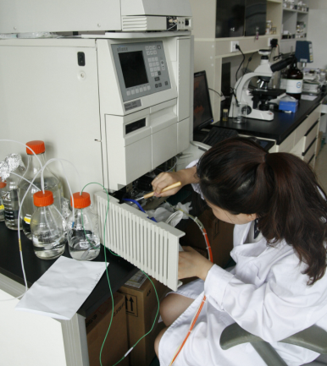
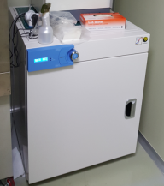
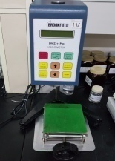
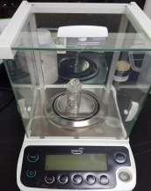
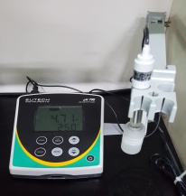
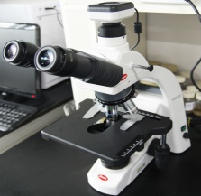
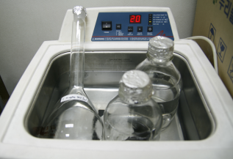
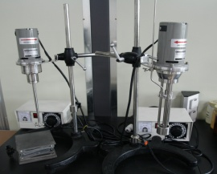
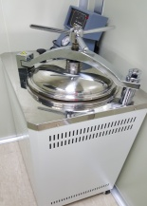
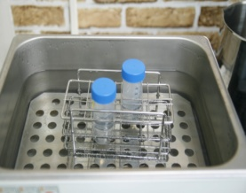
R & D
◆ Organic Cosmetics R & D Center
Producing cosmetic with no animal test and instead of using chemical ingredients, we produce
with high quality of organic and natural ingredients.
It makes your skin which exposed to chemicals, fundamentally stronger with scientific solution,
And keeps your skin healthy by using mostly plant ingredients.
www.chharmony.com

Slide 13
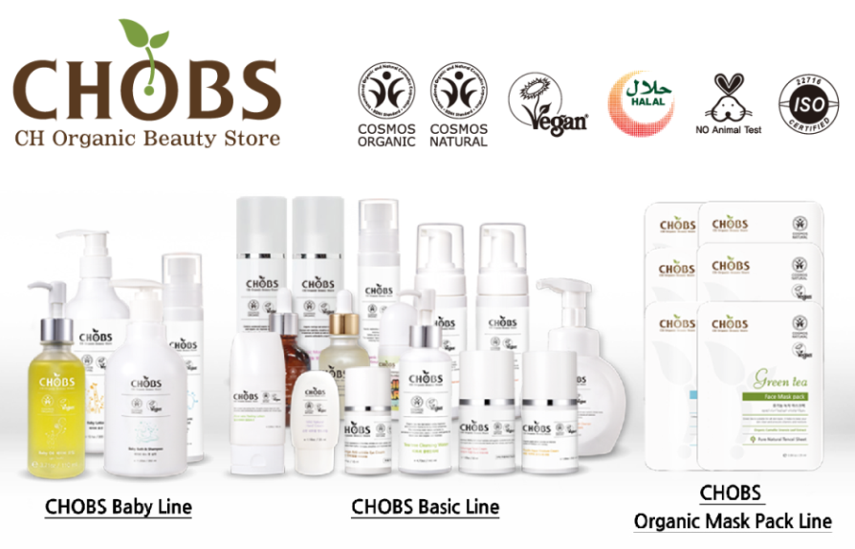
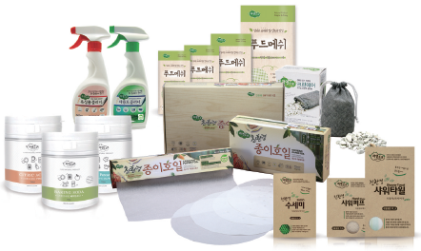
Products
Organic Cosmetics (25 Kinds) | Eco-Friendly Household goods(19 Kinds)
º Baby Line (7 kinds) -Baby Bath&Shampoo, Baby Oil, Baby Lotion, Organic baby Body mist, Bubble Hand Wash, Barumi, Baby balm
º Parchment Paper – Roll type, For Steaming,
For frying pan
º Basic Line(22 kinds) – Apple bubble Cleanser, Tea tree Cleanser Water, Aloe vera peeling Lotion, Oriental Herb Secret Cleanser150ml / 300ml, Feminine Cleansing Wipes, Organic Rosemary mist, Organic Aqua Mist(Aloe, Ravender, Rose), Moringa Toner, Moringa Lotion, Real Organic Aloe Gel , Apple aqua cream, Moringa Total cream, Moringa anti-aging eye cream, Mild Natural hand cream, Organic Centella Asiatica Serum, Lip balm(unscented, Peppermint, Lemon, Grape fruit)
º Silicone Food Mesh – Diameter 22cm, 24cm,
28cm, 38cm
º PLA(Poly Lactic Acid) goods – Scrubber,
Shower Towel, Shower Puff
º Detergent – Multi purpose cleaner(2 kinds),
Citric Acid, Sodium Bicarbonate, Sodium Percarbonate
º Organic Oil (7 kinds) –Organic Argan Treatment Oil, Real organic oil 100(30ml)
(Rosehip, Argan, Jojoba), Real organic oil 100(10ml)(Rosehip, Argan, Jojoba)
º Mask Pack Line(10 kinds) – Organic Mask Pack(Aloe, Collagen, Rice-bran, Lemon, Green Tea, Rose), Real Organic Mask Pack(Aloe, Centella Asiatica, Rose, Rosemary)
º And so on – 100% Natural zeolite(air purifier),
Hair Color Cream(3 kinds)
www.chharmony.com

Slide 14
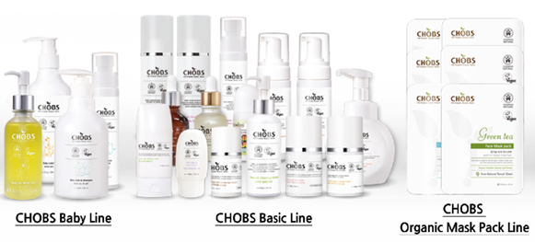
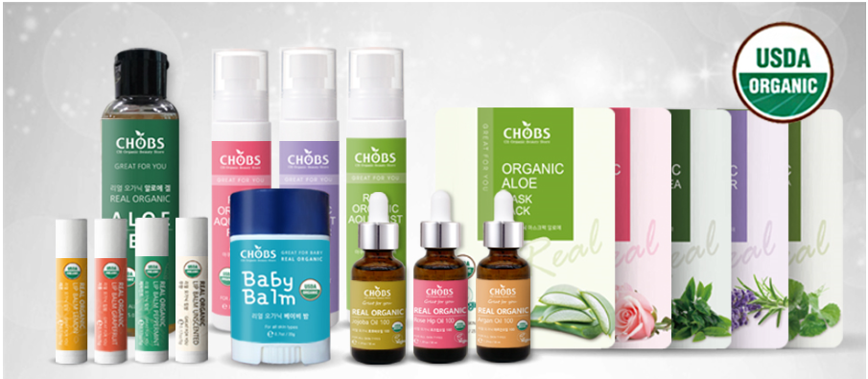
Products
º Baby Line (7 kinds) -Baby Bath&Shampoo, Baby Oil, Baby Lotion, Organic baby Body mist, Bubble Hand Wash, Barumi, Baby balm
º Basic Line(14 kinds) – Apple bubble Cleanser, Tea tree Cleanser Water, Aloe vera peeling Lotion, Oriental Herb Secret
Cleanser150ml / 300ml , Feminine Cleansing Wipes, Organic Rosemary mist, Organic Aqua Mist(Aloe, Ravender, Rose)
Organic Moringa Toner, Moringa Lotion, Real Organic Aloe Gel , Apple aqua cream, Moringa Total cream,
Moringa anti-aging eye cream, Mild Natural hand cream, Organic Centella
Asiatica Serum, Lip balm(unscented, Peppermint, Lemon, Grape fruit)
º Organic Oil (7 kinds) –Organic Argan Treatment Oil, Real organic oil 100(30ml)(Rosehip, Argan, Jojoba),
Real organic oil 100(10ml)(Rosehip, Argan, Jojoba)
º Mask Pack Line(6 kinds) – Organic Mask Pack(Aloe, Collagen, Rice-bran, Lemon, Green Tea, Rose),
Real Organic Mask Pack(Aloe, Centella Asiatica, Rose, Rosemary)
[Green Letters : CHOBS of certified USDA-NOP]
www.chharmony.com

Slide 15
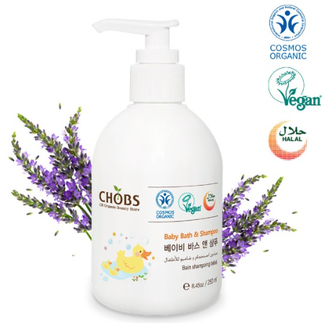
 | Certificates | º BDIH COSMOS-ORGANIC º Vegan º HALAL(Esma, UAE)
 | Product Features | Keep your baby healthy & safe: No Chemicals. No Parabens, No Phosphates, No Sulfates. Natural Lavender and Organic Nutri-Soothe Complex º Best Calming Bubble Bath and Wash for Soothing Sensitive Skin
 | The main Ingredients | º Organic Glycerin, Organic Lavandula Angustifolia (Lavender) Extract, Organic Citrus Aurantium Bergamia (Bergamot) Fruit Oil, Organic Citrus Limon (Lemon) Peel Oil, Organic Lavandula Angustifolia (Lavender) Oil º 98.1% natural origin of total by COSMOS-Standard
 | The Dose | º 250 ml (e 8.45oz)
 | Retail Price | º USD $24.5
 | How to Use | º Pour a few pump into your hand, washcloth or directly into bath. Wash baby's wet skin and hair. Rinse well.
 | Size | º Q’ty 20ea
 |  | º Unit L70 * W70 *163mm | º Box L71 * W71 *163mm
 |  | º 20FT(unit Qty(ea)) : 26,320 | º 20FT(C/T Qty,28CBM,Box): 1,316
Baby Bath&Shampoo
www.chharmony.com

Slide 16
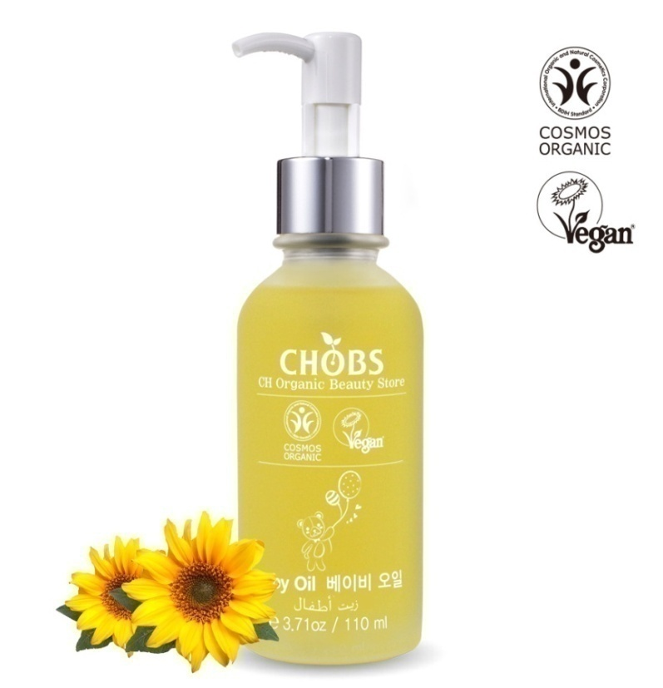
 | Certificates | º BDIH COSMOS-ORGANIC º Vegan º HALAL(Esma, UAE)
 | Product Features | º Daily skin hydrator for all skin types providing instant relief from environmental stresses. Keeps your skin healthy, smooth and calm on all occasions. º Repairing plant oils, helps to restore skin balance º Organic Rosemary leaf Water helps provide relief from irritated skin. º Suitable for baby skin.
 | The main Ingredients | º Organic Glycerin, Organic Lavandula Angustifolia (Lavender) Extract, Organic Citrus Aurantium Bergamia (Bergamot) Fruit Oil, Organic Citrus Limon (Lemon) Peel Oil, Organic Lavandula Angustifolia (Lavender) Oil º 98.1% natural origin of total by COSMOS-Standard
 | The Dose | º 110 ml (e 3.71oz)
 | Retail Price | º USD $30
 | Size | º Q’ty 20
 |  | º Unit L54 * W54 *H163mm | º Box L290 * W235 *185mm
 |  | º 20FT(unit Qty(ea)) : 44,240 | º 20FT(C/T Qty,28CBM,Box): 2.212
Baby Oil
www.chharmony.com

Slide 17
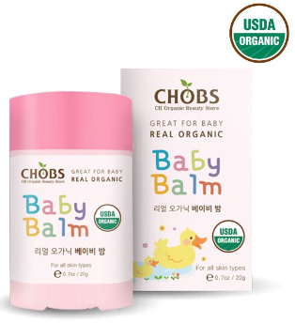
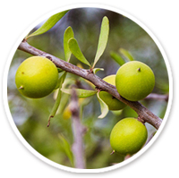
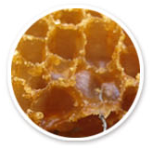
 | Certificate | º UDSA-NOP
 | Product Features | º For dry, irritated, chapped, cracked skin. º Softens and soothes delicate baby skin. Helps heal and protect sensitive areas. Helps reduce redness and inflammation. º Keep it handy for those dry baby lips and cheeks, especially during the cold time of the year. Infused with nourishing ingredients
 | Main Ingredients | º Organic simmondsia Chinensis(jojoba) seed oil, Organic beeswax, Organic argan spinosa kernel oil º 96.8% Organic Ingredients
 | The dose | º 20g (0.7oz)
 | Direction | º Apply liberally to affected skin. Use as often as necessary.
Real Organic Baby balm
Organic Argan oil
Organic Beeswax
.
Organic Rosehip oil
www.chharmony.com

Slide 18
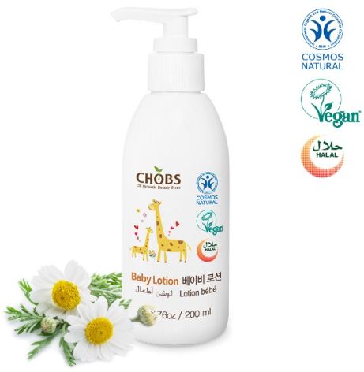
 | Certificates | º BDIH COSMOS-NATURAL º Vegan º HALAL(Esma, UAE)
 | Product Features | º Naturally nourishing: Skin Moisturizer helps you to protect your baby’s’ delicate skin from eczema, seborrhea and rash Best for newborns, babies, and adults with sensitive skin. It is a non-greasy, naturally nourishing formula that absorbs in the skin quickly without clogging pores and locks in 24 hours of moisture Strengthens baby natural balance: Excellent baby lotion for dry skin by moisturizing to strengthen baby's natural skin barrier. 100% Plant Based Ingredients: Which means you avoid applying harsh ingredients to your baby's sensitive skin
 | The main Ingredients | º Organic Simmondsia Chinensis (jojoba) Seed Oil, Organic Butyrospermum Parkii (Shea) Butter, Organic Rosmarinus officinalis (Rosemary) Extract, Organic Chamomilla Recutita (Matricaria) Flower Water º 100% natural origin of total by COSMOS-Standard
 | The dose | º 200 ml (e 10.1oz)
 | Retail Price | º USD $27.8
 | How to Use | º Massage lotion daily on your baby's skin. For best use after your baby's bath.
 | Size | º Q’ty 20
 |  | º Unit L61 * W61 *H179mm/ | º Box L325 * W260 *H200mm
 |  | º 20FT(unit Qty(ea)) : 33,040 | º 20FT(unit Qty(ea)) : 33,040
Baby Lotion
www.chharmony.com

Slide 19
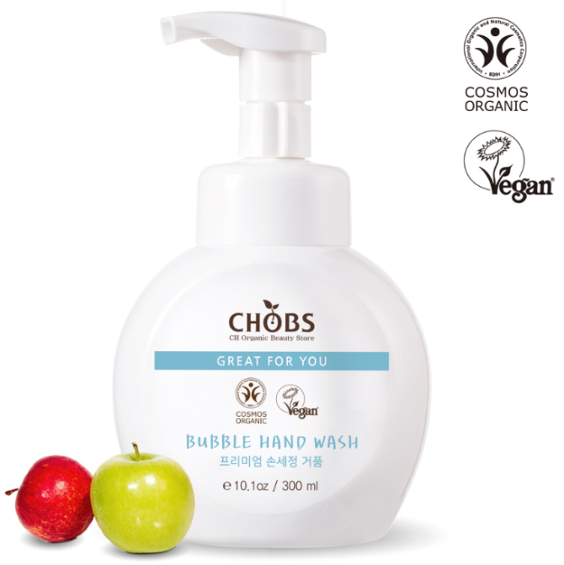
 | Certificates | º BDIH COSMOS-ORGANIC º Vegan
 | Product Features | º Keep your baby healthy & safe: No Chemicals. No Parabens, No Phosphates, No Sulfates. º This hand wash creates fluffy bubbles. º Enriched with organic extracts, this lightweight hand wash will leave your hands clean and moisturized. º Generously enriched with organic extracts to leave your hands clean and moisturized.
 | The main Ingredients | º Organic Pyrus Malus (apple) Fruit Water, Organic Chamomilla Recutita (Matrica) Flower Water, Organic glycerin, Organic Aloe Barbadensis Leaf Water. º 20% Organic of total by COSMOS-Standard
 | The dose | º 300 ml (e 10.1oz)
 | Retail Price | º USD $17.5
 | How to Use | º Pump desire amount onto wet hands. Rinse well and tower dry.
 | Size | º Q’ty 16
 |  | º Unit L96 *W66 *H161mm | º Box L400 *W280 *H180mm
 |  | º 20FT(unit Qty(ea)) : 21,952 | º 20FT(C/T Qty,28CBM,Box):1,372
Bubble Hand wash
www.chharmony.com

Slide 20
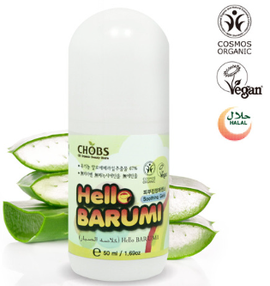
 | Certificates | º BDIH COSMOS-ORGANIC º Vegan º HALAL(Esma, UAE)
 | Product Features | º Experience moisturized skin! º Provides nutrients and soothes º Convenient roll-on type º Complete skin moisturization
 | Ingredients | º Organic Aloe Barbadensis Leaf Extract, Organic Glycerin, Organic Chamomilla Recutita(Matricaria) Flower Water, Organic Camellia Sinensis Leaf Extract, Organic Simmondsia Chinensis(Jojoba) Seed Oil º 21% organic of total by COSMOS-Standard
 | The dose | º 50ml (e 1.69 oz)
 | Retail Price | º USD $6.6
 | How to Use | º Use all the skins, at any moment of the day to soothe, hydrate and refresh
 | Size | º Q’ty 40
 |  | º Unit L41 * W41 *H108mm | º Box L345 * W225 *H130mm
 |  | º 20FT(unit Qty(ea)): 110,880 | º 20FT(C/T Qty,28CBM,Box): 2,772
Organic Hello Barumi
www.chharmony.com

Slide 21
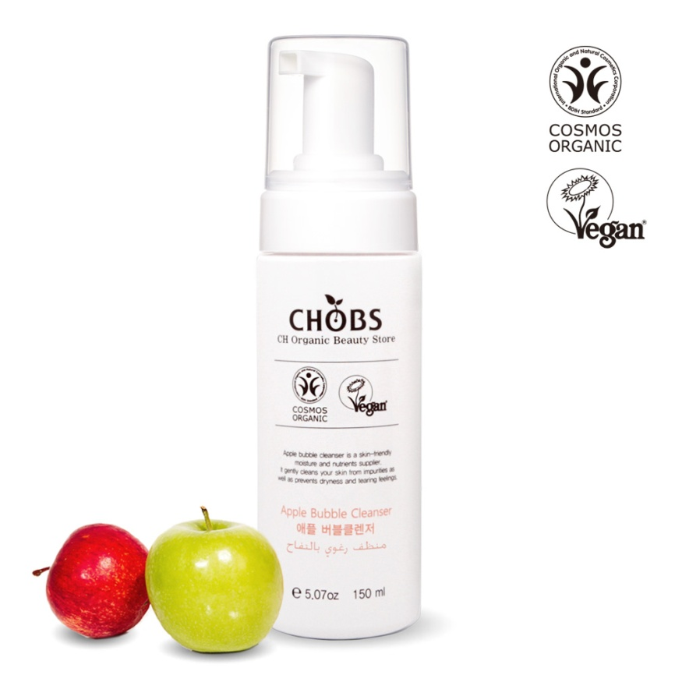
 | Certificates | º BDIH COSMOS-ORGANIC º Vegan º HALAL(Esma, UAE)
 | Product Features | Renews skin tone and texture and brightens with organic apple water, tea tree leaf water. Smooth and refreshing! Abundant foam with each pump for convenient use.
 | The main Ingredients | º Organic Pyrus Malus (Apple) Fruit Water, Organic Melaleuca Alternifolia (Tea Tree) Leaf Water, Organic Portulaca Oleracea Extract, Pulsatilla Koreana Extract º 99.3% natural origin of total by COSMOS-Standard
 | The dose | º 150 ml (e 5.07oz)
 | Retail Price | º USD $23
 | How to Use | º Wet hands and face. Work a small amount of cleanser into lather and massage onto face, avoiding eye area. Rinse thoroughly.
 | Size | º Q’ty 30
 |  | º Unit L50 * W50 *H178mm | º Box L320 * W270 *H195mm
 |  | º 20FT(unit Qty(ea)) : 108,360 | º 20FT(C/T Qty,28CBM,Box): 3,612
Apple bubble Cleanser
www.chharmony.com

Slide 22
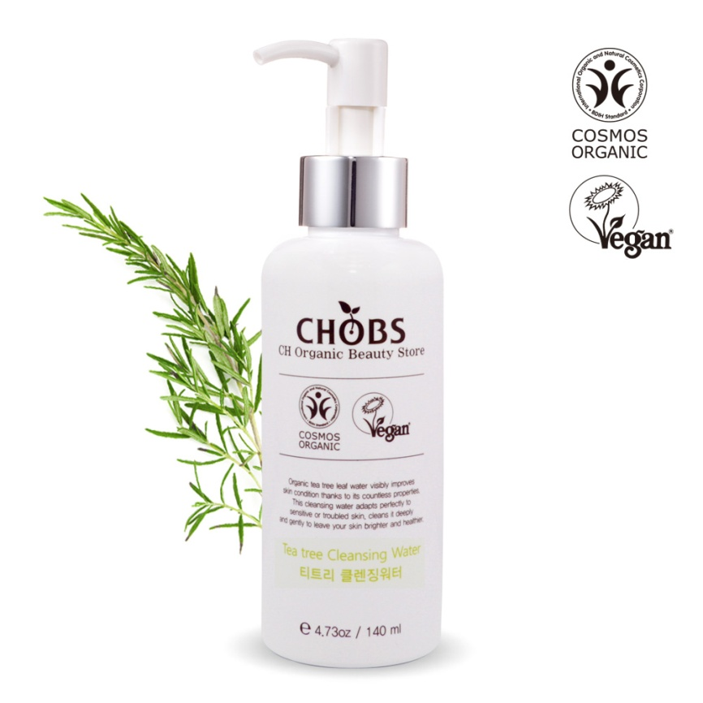
 | Certificates | º BDIH COSMOS-ORGANIC º Vegan º HALAL(Esma, UAE)
 | Product Features | º Contains tea tree leaf water º Provides skin moisture giving light point make up and impurities cleansing. º Mild and soft wipe out with no need of separate water wash for moisture clean finish. º No addition of artificial color, artificial flavor, benzophenone, parabens, animal raw materials, mineral oil.
 | The main Ingredients | º Organic Melaleuca Alternifolia (Tea Tree) Leaf Water, Organic Citrus Limon (Lemon) Leaf Extract, Organic Alcohol, Organic Oryza Sativa (Rice) Bran Extract º 20% organic of total by COSMOS-Standard
 | The dose | º 140 ml (e 4.73oz)
 | Retail Price | º USD $18
 | How to Use | º Wet hands and face. Work a small amount of cleanser into lather and massage onto face, avoiding eye area. Rinse thoroughly.
 |  | º Q’ty 30
 |  | º Unit L48 *W48 *H158mm | º Box *L305 *W260 *H175mm
 |  | º 20FT(unit Qty(ea)): 60,480 | º 20FT(C/T Qty,28CBM,Box): 2,016
Tea tree Cleanser Water
www.chharmony.com

Slide 23
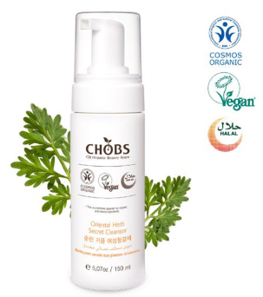
 | Certificates | º BDIH COSMOS-NATURAL º Vegan º HALAL(Esma, UAE) º Completed U.S. FDA Test
 | Product Features | º Gentle foaming women’s cleanser º Gentle and smooth feeling that lasts. Each pump gives abundant foam for convenience. º Smooth and refreshing! Abundant foam with each pump for convenient use. º Generous amount of oriental and medicinal herbs used.
 | The main Ingredients | º Organic Artemisia Vulgaris Extract, Organic Pyrus Malus(Apple) water, Coco-Betain, Organic Pelargonium Graveolens Oil, Organic Lavandula Angustifolia (Lavender)Oil º 99.6% natural origin of total by COSMOS-Standard
 | The dose | º 150ml(e 5.07oz)
 | Retail Price | º USD $20
 | How to Use | º Wash your hands and wet external vaginal area. Press the pump until you have enough quantity of product. Apply externally on the vaginal area and gently clean. Rinse thoroughly.
 | Size | 150ml
 |  | º Q’ty 30
 |  | º Unit L50 *W50 *H178mm º Box L320 *W270 *H195mm
 |  | º 20FT(unit Qty(ea)) :48,090 º 20FT(C/T Qty,28CBM,Box): 1,603
Oriental Herb Secret Cleanser
www.chharmony.com

Slide 24
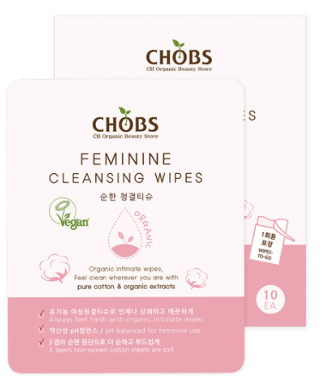
 | Certificates | º Vegan
 | Product Features | º Organic intimate wipes, feel clean wherever you are with pure cotton & organic extracts. º pH balanced for feminine use º Always feel fresh with organic intimate wipes º 3 layers non-woven cotton sheets are soft º Individually- wrapped
 | The main Ingredients | º Organic Artemisia Vulgaris Extract, Organic Aloe Barbadensis Leaf extract, Organic Glycerin, Organic Mentha Piperita (Peppermint) Oil º 57.9% organic of total by MFDA
 | The dose | º 5g * 10ea
 | Retail Price | º USD $11.5
 | How to Use | º Remove cloth from foil packet. Gently wipe your intimate area from front to back.
 | Size | º Q’ty : 30
 |  | º Unit L110 *W60 *H137mm | º Box L575 *W385 *H155mm
 |  | º 20FT(unit Qty(ea)): 23,610 | º 20FT(C/T Qty,28CBM,Box): 787
Feminine Cleansing Wipes
www.chharmony.com

Slide 25
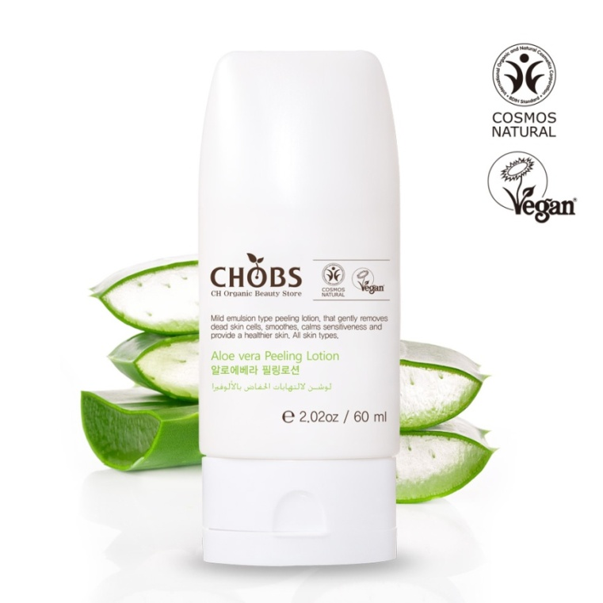
 | Certificates | º BDIH COSMOS-NATURAL º Vegan º HALAL(Esma, UAE)
 | Product Features | 100% Plant Based Ingredients After removing the dead skin cells, it produces a biopolymer film that protects the skin by influencing the supple layer of skin It gives a much smoother appearance to the skin and improves skin texture and tone.
 | The main Ingredients | º Cellulose, Organic Aloe Barbadensis Leaf Extract, Organic Aloe Barbadensis Leaf Juice, Organic Citrus Limon (Lemon) Leaf Extract, Organic Glycerin º 100% natural origin of total by COSMOS-Standard
 | The dose | º 60 ml (e 2.02oz)
 | Retail | º USD $11
 | How to Use | º After washing the face and dry it. Dispense a suitable amount and massage the face except around eyes and mouth. Finally, wash it off with lukewarm water.
 | Size | º Q’ty 20
 |  | º Unit L51 *W32 *H156mm | º Box L270 *W145 *H175mm
 |  | º 20FT(unit Qty(ea)): 81,200 | º 20FT(C/T Qty,28CBM,Box): 4,060
Aloe Vera Peeling Lotion
www.chharmony.com

Slide 26
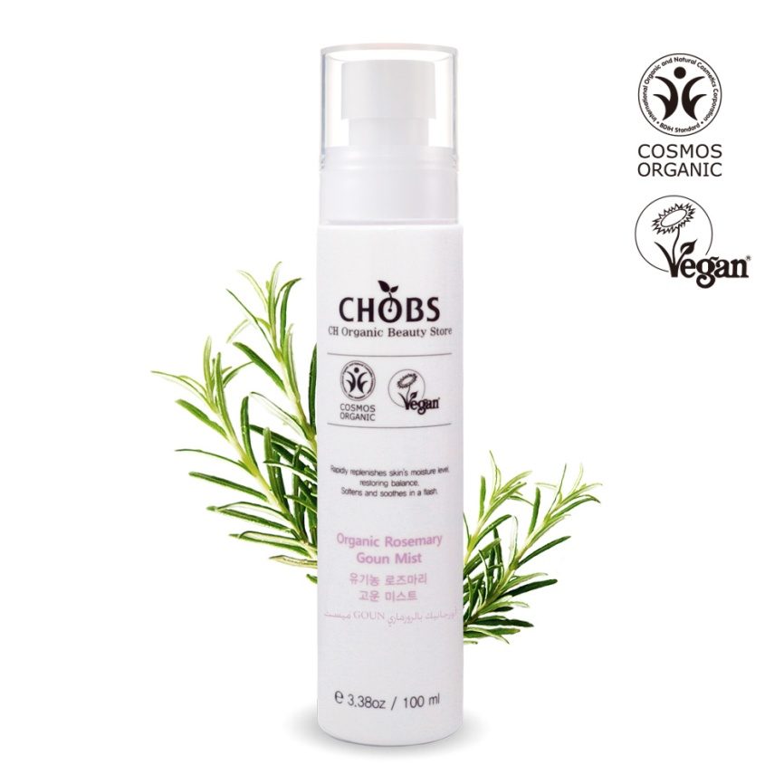
 | Certificates | º BDIH COSMOS-ORGANIC º Vegan º HALAL(Esma, UAE)
 | Product Features | Daily skin hydrator for all skin types providing instant relief from environmental stresses. Keeps your skin healthy, smooth and calm on all occasions. Bio-Boost, This works‘ blend of repairing plant oils, helps to restore skin balance Organic Rosemary leaf Water helps provide relief from irritated skin. Suitable for sensitive skin.
 | The main Ingredients | º Organic Rosmarinus Officinalis (Rosemary) Leaf Water, Organic Lavandula Angustifolia (Lavender) Oil, Organic Citrus Tangerina (Tangerine) Peel Oil º 21% organic of total by COSMOS-Standard
 | The dose | º 100 ml (e 3.38oz)
 | Retail Price | º USD $22
 | How to Use | º Mist generously onto cleansed skin, lightly after applying makeup. Spray throughout the day for a cooling, refreshing boost.
 | Size | º Q’ty 30
 |  | º Unit L38 *W38 *H176mm | º Box *L245 *W210 *H195mm
 |  | º 20FT(unit Qty(ea)): 83,160 | º 20FT(C/T Qty,28CBM,Box): 2,772
Organic Rosemary mist
www.chharmony.com

Slide 27
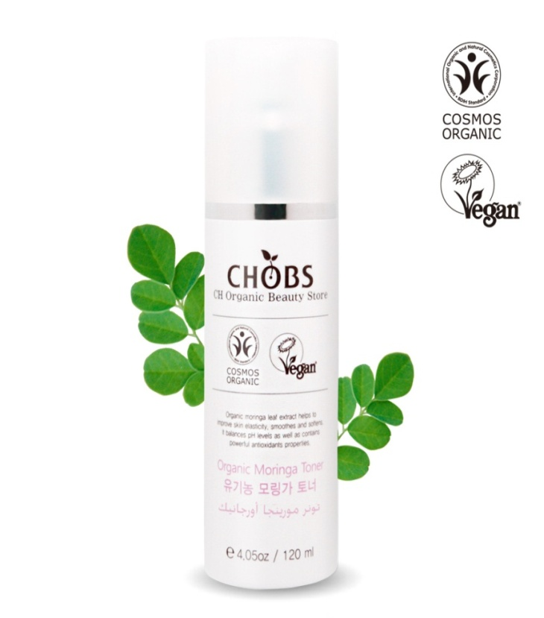
 | Certificates | º BDIH COSMOS-ORGANIC º Vegan º HALAL(Esma, UAE)
 | Product Features | 100% Plant Based Ingredients, No harmful chemicals, No Parabens, No Phthalates, No Alcohol, No formaldehyde Your skin solution: Moisture & Hydrating Face Toner Gentle: Safe and beneficial for all skin types
 | The main Ingredients | º Organic Moringa Oleifera Leaf Extract, Organic Aloe Barbadensis Leaf Extract, Organic Lavandula Angustifolia (Lavender) Extract, Organic Pyrus Malus (Apple) Fruit Water º 24% organic of total by COSMOS-Standard
 | Retail | º USD $25
 | The dose | º 120 ml (e 4.05oz)
 | How to Use | º Moisten a cotton ball and apply to your face in a gentle stroking motion. Do not rinse.
 | Size | º Q’ty 30
 |  | º Unit L47 *W47 *H156mm | º Box L300 *W255 *H175mm
 |  | º 20FT(unit Qty(ea)): 62,160 | º 20FT(C/T Qty,28CBM,Box): 2,072
Organic Moringa Toner
www.chharmony.com

Slide 28
 | Certificates | º BDIH COSMOS-ORGANIC º Vegan º HALAL(Esma, UAE)
 | Product Features | Lightweight yet hydrating lotion. It’s ingredients to deliver immediate moisturizer to dry skin. 100% Plant Based Ingredients: Safe-effective alternative to other products with harsh chemicals. Helps condition skin for a healthier look and feel; Helps provide dramatic skin hydration and nourishment.
 | The main Ingredients | º Organic Moringa Oleifera Leaf Extract, Organic Lavandula Angustifolia (Lavender) Extract, Organic Prunus Amygdalus Dulcis (Sweet Almond) Oil, Organic Persea Gratissima (Avocado) Oil º 22% organic of total by COSMOS-Standard
 | The dose | º 110 ml (e 3.71oz)
 | Retail price | º USD $18
 | How to Use | º Massage lotion daily on your baby's skin. For best use after your baby's bath.
 | Size | º Q’ty 30
 |  | º Unit L47 *W47 *H156mm | º Box *L300 *W255 *H175mm
 |  | º 20FT(unit Qty(ea)): 62,160 | º 20FT(C/T Qty,28CBM,Box): 2,072
Moringa Lotion
www.chharmony.com

Slide 29
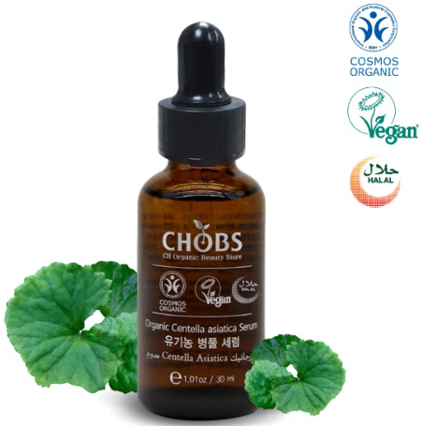
 | Certificates | º BDIH COSMOS-ORGANIC º Vegan º HALAL(Esma, UAE)
 | Product Features | º Firm sensitive skin using Centella Asiatic! º Centella Asiatica! Superior skin calming qualities º Skin firming º Refreshing essence for clear and elastic skin.
 | Ingredients | º Organic Centella Asiatica Leaf Water, Organic Chamomilla Recutita(Matricaria) Flower Water, Organic Portulace Oleracea Extract º 21% organic of total by COSMOS-Standard
 | The dose | º 30ml (e 1.01oz)
 | Retail Price | º USD $42
 | How to Use | º Taking care to cover all affected areas of the face and neck. Allow time for serum to penetrate skin.
 | Size | º Q’ty 30
 |  | º Unit L38 *W38 *H107mm | º Box L245 *W210 *H125mm
 |  | º 20FT(unit Qty(ea)): 130,200 | º 20FT(C/T Qty,28CBM,Box): 4,340
Organic Centella Asiatica Serum
www.chharmony.com

Slide 30
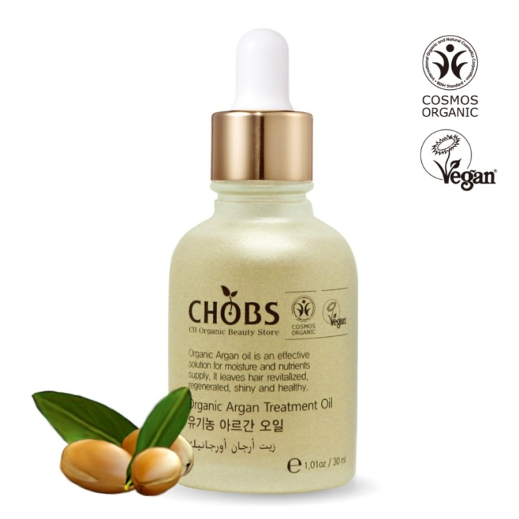
 | Certificates | º BDIH COSMOS-ORGANIC º Vegan º HALAL(Esma, UAE)
 | Product Features | 100% Plant Based Ingredients It is rich in vitamins and has strong moisturizing skills. Treat dry, brittle, frizzy & damaged hair Delivered in amber glass bottle with a glass dropper for ease-of-use
 | The main Ingredients | º Organic Oenothera Biennis (Evening Primrose) Oil, Organic Argania Spinosa Kernel Oil, Organic Helianthus Annuus (Sunflower) Seed Oil, Organic Citrus Aurantium Bergamia (Bergamot) Fruit Oil º 99% organic of total by COSMOS-Standard
 | The dose | º 30 ml (e 1.01oz )
 | Retail Price | º USD $26
 | How to Use | º Use 2 drops for skin treatment. Rub between palms then massage onto desired area for 1 minute. Use a pea size amount for hair treatment.
 | Size | º Q’ty 20
 |  | º Unit L45 *W45 *H101mm | º Box L245 *W200 *H120mm
 |  | º 20FT(unit Qty(ea)): 95,200 | º 20FT(C/T Qty,28CBM,Box): 4,760
Organic Argan Treatment Oil
www.chharmony.com

Slide 31
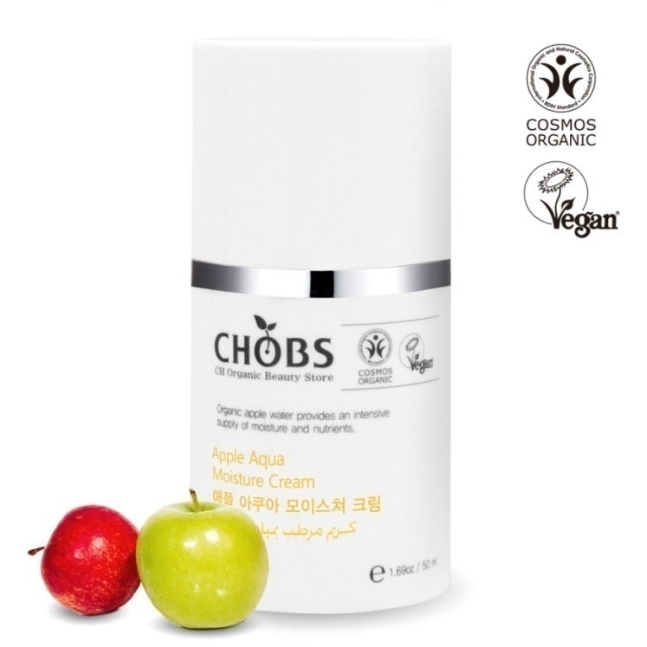
 | Certificates | º BDIH COSMOS-ORGANIC º Vegan º HALAL(Esma, UAE)
 | Product Features | º This cream leaves your skin hydrated all-day long. Hyaluronic ingredients keep your skin moisturized. Moisture rich formula has the same hydrating effect as a face pack, providing round the clock hydration to keep skin soft and smooth, with a dewy and luminous finish. Lightweight yet ultra-hydrating cream is 100% plant based ingredients to deliver immediate moisturizer to dry skin.
 | The main Ingredients | º Organic Pyrus Malus (Apple) Fruit Water, Organic Glycerin, Organic Chamomilla Recutita (Matricaria) Flower Water, Organic Lavandula Angustifolia (Lavender) Extract º 21% organic of total by COSMOS-Standard
 | The dose | º 50 ml (e 1.69oz)
 | Retail Price | º USD $35
 | How to Use | º Apply on clean and dry skin Massage gently until absorption
 | Size | º Q’ty 20
 |  | º Unit L51 *W51 *H104mm | º Box L245 *W224 *H125mm
 |  | º 20FT(unit Qty(ea)): 72,240 | º 20FT(C/T Qty,28CBM,Box): 3,612
Apple aqua cream
www.chharmony.com

Slide 32
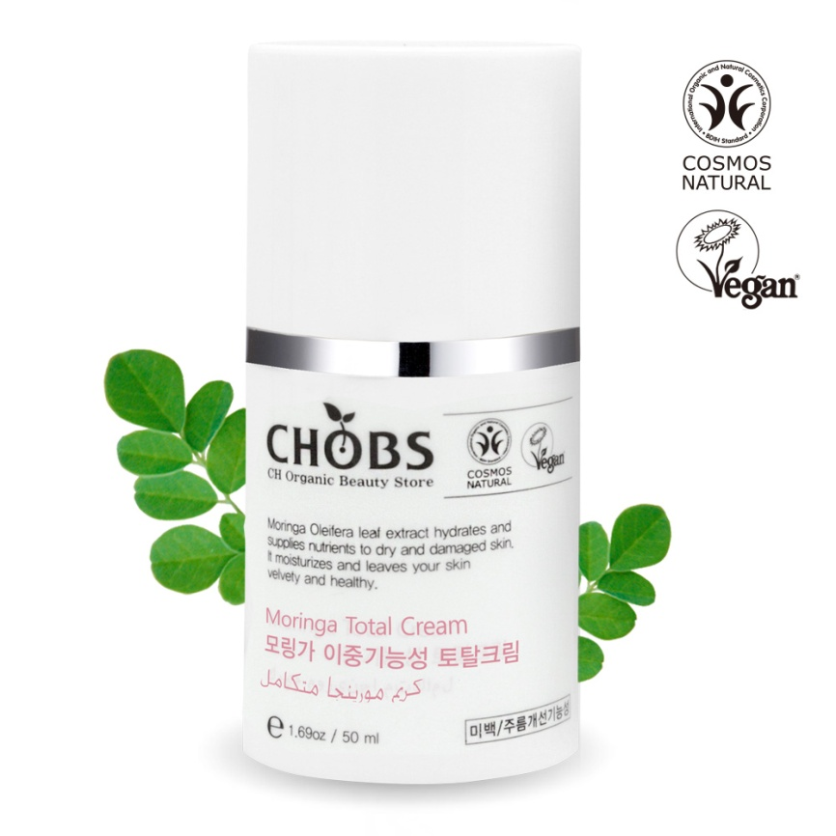
 | Certificates | º BDIH COSMOS-NATURAL º Vegan º HALAL(Esma, UAE)
 | Product Features | º Daily, all-in-one face moisturizer for younger-looking skin Anti-Aging Natural Day and Night face cream with organic ingredients. Whitening cream for Sensitive skin: This is specifically designed to be gentle on your skin, without any harsh chemicals or perfumes
 | The main Ingredients | º Adenosine, Glycyrrhiza Glabra (Licorice) Root Extract ,Organic Olea Europaea (Olive) Fruit Oil, Organic Helianthus Annuus (Sunflower) Seed Oil, Organic Moringa Oleifera Leaf Extract º 100% natural origin of total by COSMOS-Standard
 | The dose | º 50 ml (e 1.69oz)
 | Retail Price | º USD $46
 | How to Use | º Tapping the appropriate amount absorbed into the skin. Daily Use.
 | Size | º Q’ty 20
 |  | º Unit L51 *W51 *H104mm | º Box L275 *W220 *H125mm
 |  | º 20FT(unit Qty(ea)): 32,920 | º 20FT(C/T Qty,28CBM,Box): 3,696
Moringa Total cream
www.chharmony.com

Slide 33
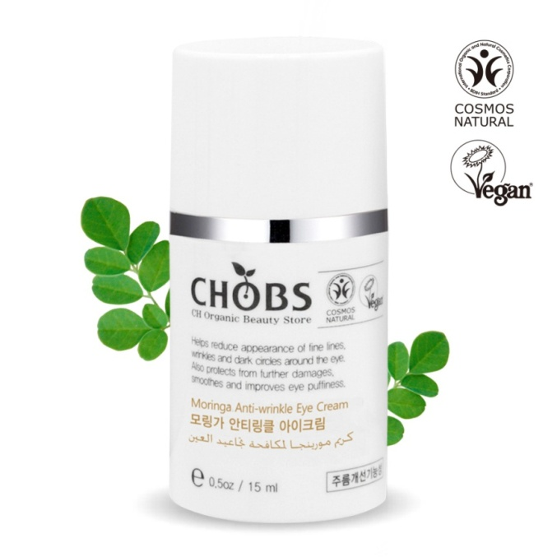
 | Certificates | º BDIH COSMOS-NATURAL º Vegan º HALAL(Esma, UAE)
 | Product Features | Moringa Anti-Aging Eye Cream is Specifically Formulated with Nourishing Hydration for the Delicate Eye Area. Restore and rejuvenate - Moisturize and Hydrate Dry Under Eye Skin While Fighting Signs Of Aging. Use Day and Night to Reveal A Brighter and Younger Looking You.
 | The main Ingredients | º Adenosine, Organic Olea Europaea (Olive) Fruit Oil, Organic Helianthus Annuus (Sunflower) Seed Oil, Organic Moringa Oleifera Leaf Extract, Organic Persea Gratissima (Avocado) Oil º 100% natural origin of total by COSMOS-Standard
 | The dose | º 15 ml (e 0.5oz)
 | Retail Price | º USD $33
 | How to Use | º Apply in small dots around the eye area and gently smooth until thoroughly absorbed.
 | Size | º Q’ty 30
 |  | ºUnit L39 *W39 *H80mm | ºBox *L255 *W215 *H100mm
 |  | º 20FT(unit Qty(ea)): 152,880 | º 20FT(C/T Qty,28CBM,Box): 5,096
Moringa anti-aging eye cream
www.chharmony.com

Slide 34
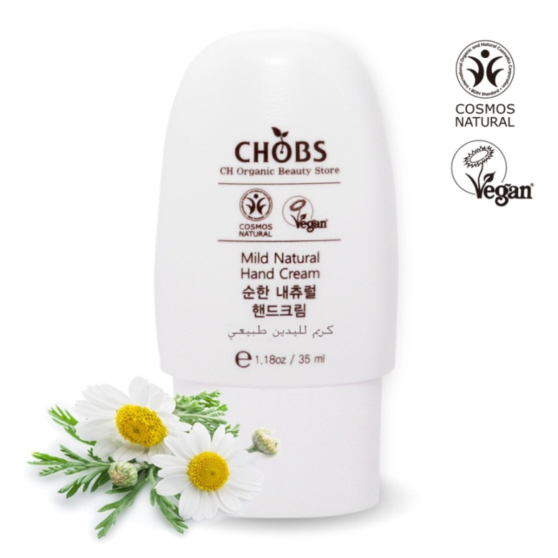
 | Certificates | º BDIH COSMOS-NATURAL º Vegan º HALAL(Esma, UAE)
 | Product Features | Protects, nourishes and moisturizes hands. Leaves hands soft and smooth with no oily traces. º Just one application for all day protection. º With regular use, this nourishing formula keeps hands intensively moisturized even after washing.
 | The main Ingredients | º Organic Simmondsia Chinensis (Jojoba) Seed Oil, Organic Glycerin, Organic Butyrospermum Parkii (Shea) Butter, Organic Artemisia Vulgaris Extract º 100% natural origin of total by COSMOS-Standard
 | The dose | º 35 ml (e 1.18oz)
 | Retail Price | º USD $7.9
 | How to Use | º Apply to hands and use as often as needed throughout the day
 | Size | º Q’ty 30
 |  | º Unit L47 *W27 *H90 | º Box L300 *W155 *H110
 |  | º 20 Ft(Unit Qty (ea)): 163,800 | º 20Ft(C/T Qty 28CBM,Box):5,460
Mild hand cream
www.chharmony.com

Slide 35
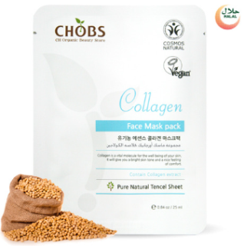
 | Certificates | º BDIH COSMOS-NATURAL º HALAL(Esma, UAE) º Vegan
 | Product Features | º Make your skin elastic with a moisture-rich mask pack! º Generous amount of “organic rosemary leaf water” used. º Moisturizes skin and supplies nutrients for clear skin.
 | The main Ingredients | º Organic Rosmarinus Officinalis (Rosemary) Leaf Water, Organic Aloe Barbadenaia Leaf Juice, Collagen Extract º 100% natural origin of total by COSMOS-Standard
 | The dose | º 25ml (e 0.84oz), Pure Natural Tencel Sheet
 | Retail Price | º USD $2.6
 | How to Use | (1)After cleansing, use toner to refine skin texture. (2)Take out the mask from package and spread evenly over entire face, avoiding the eye and lip area. (3)Remove the sheet after 10~20 minutes and gently pat to allow the remaining formula into the skin.
 | Size | º Q’ty 180
 |  | º Unit L120 *W2 *H160mm | º Box L400 *W250 *H190mm
 |  | º 20FT(unit Qty(ea)): 262,080 | º 20FT(C/T Qty,28CBM,Box): 1,456
Organic Mask Pack
(Aloe, Green tea, Rice bran,
Collagen, Rose, Lemon)
www.chharmony.com

Slide 36
 | Certificate | º UDSA-NOP
 | Feature | º Best for healing cracked, chapped lips with vitamin E and Beeswax for intensive moisture. This delicious creamy balm is the perfect set for men women and kids. º CHOBS Lip balm gives you essential protection no matter your environment by creating a barrier between you and the elements. º Energize your lips with Organic lip balms. Safe for even the most Sensitive Lips.
 | Main Ingredients | º Organic bees wax, organic jojoba oil, Organic Argan kernel oil º Unscented- 99% Organic Ingredients º Peppermint- 96.7% Organic Ingredients º Grapefruit- 96.4% Organic Ingredients º Lemon- 96.4% Organic Ingredients
 | The dose | º 5g (0.17oz)
 | Direction | º Use daily for chapped or dry lips. Apply lip balm to clean lips or under lip sticks.
Real Organic Lip Balm
(Unscented, Peppermint, Grapefruit, Lemon)
Organic Argan oil
Organic Beeswax
.
Organic Rosehip oil
www.chharmony.com

Slide 37
 | Certificates | º UDSA-NOP º Vegan
 | Features | º An excellent daily treatment for face, skin & hair. Regular use soothes the skin leaving it soft and supple with a healthy glow. º Your skin will feel refreshed, not greasy. º Moisturizing for skin, hair, and cuticles. Great for sunburn and razor burn. Use as after shave, hair gel, or leave in conditioner; also great for pets. Thin gel absorbs quickly with no sticky residue, leaving skin silky and smooth
 | Main Ingredients | º Organic Maculata Leaf Water, Organic Glycerin, Organic Centella Asiatica Leaf Water º 97.5% Organic Ingredients(Minus water) 100% Ingredients originated from natural
 | The dose | º 150ml (5.07oz)
 | Direction | ºApply directly to the skin and let it air dry for best result. Use it for healthier skin and sun burns. It can be added to massage oils, daily facial care products.
Real Organic Aloe Gel
Organic Maculata Leaf Water
Organic moringa leaf
water
Organic Centella Asiatica Leaf Water
www.chharmony.com

Slide 38
 | Certificates | º UDSA-NOP º Vegan
 | Features | Daily skin hydrator for all skin types providing instant relief from environmental stresses. Keeps your skin healthy, smooth and calm on all occasions. Bio-Boost, This works‘ blend of repairing plant oils, helps to restore skin balance Organic Lavender Flower extract , Organic Aloe Maculata Leaf water and Organic Rose Damascena Flower water helps provide relief from irritated skin.
 | Main Ingredients | º Aloe Mist-Organic Aloe Maculate Leaf Water 99.9% Organic Ingredients(Minus water) 100% Ingredients originated from natural º Rose Mist-Organic Damascena Flower Water 99.9% Organic Ingredients(Minus water) 100% Ingredients originated from natural º Lavender Mist-Organic Lavender Water 99.8% Organic Ingredients(Minus water) 100% Ingredients originated from natural
 | The dose | º 100ml (3.38oz)
 | Direction | º Mist generously onto cleansed skin, lightly after applying makeup. Spray throughout the day for cooling. Refreshing boost.
유기농 아쿠아 미스트
(알로에,라벤더,로즈)
www.chharmony.com

Slide 39
 | Certificate | º UDSA-NOP º Vegan
 | Product Feature | º100% Ingredients originated from natural º Organic Aloe Leaf Extract: Quickly relieves irritated skin, used as a skin conditioning, to soften the skin. It also contains lots of water, which helps bring healing to the skin. º Organic Centella Asiatica Leaf Water: The elements of Madecasic acid in the leaves and stems of a Centella leaf helps in soothing and cleaning irritated skin, thereby contributing to a healthy skin. º Organic Damascus Rose Flower water: Helps in soothing and smoothing the skin texture º Organic Lavender Flower Extract: It helps form a protective layer and allow the skin retain moisture for a long time. º Organic Green Tea extract is the main ingredient, excellent for its moisturizing properties
 | Main Ingredients | º Organic herb(Centella Asiatica, Rose, Aloe, Lavender, Green Tea) Water or Extracts º Organic of Total -Lavender: 98.5% / -Rose : 98.4% / -Centella Asiatica : 98.5% / -Aloe : 98.7% /-Green tea :98.4%
 | The Dose | º 25ml (0.84oz), Organic Cotton sheet
 | How to Use | (1)After cleansing, use toner to refine skin texture. (2)Take out the mask from package and spread evenly over entire face, avoiding the eye and lip area. (3)Remove the sheet after 10~20 minutes and gently pat to allow the remaining formula into the skin.
 | Size | º Q’ty 180
 |  | º Unit L120 *W2 *H160mm | º Box L400 *W250 *H190mm
 |  | º 20FT(unit Qty(ea)): 262,080 | º 20FT(C/T Qty,28CBM,Box): 1,456
Organic Mask pack
(Centella Asiatica, Rose, Aloe, Lavender, Green Tea)
www.chharmony.com

Slide 40
 | Certificate | º UDSA-NOP º Vegan
 | Product Feature | º Organic Argan oil - Body, Hair & Face Treatment. Restores elasticity, softens wrinkles and fine lines, heals dry scalp, and restores nutrient content to skin cells treating an array of skin conditions. Effective to treat all hair, scalp and skin types. Gentle enough for daily use. º Organic Rosehip Oil- FULL BODY & HAIR TREATMENT. This pure, natural, organic oil restores elasticity, softens wrinkles and fine lines, heals dry scalp stimulating hair regeneration, and restores nutrient content to skin cells treating an array of skin conditions. º Organic Jojoba Oil -Best Jojoba Oil for Face, Hair & Body. The Jojoba Essential Oil has remarkable effects on the skin ,scalp, beard and hair, and It can be used for all skin types.
 | Main Ingredients | º 100% Organic Ingredients º 100% Ingredients originated from natural
 | The Dose | º 30ml (1.01oz) / 10ml
 | How to Use | º Generally massage 2~3 drops into face, body morning and/or night.
 | Size | Q’ty - 30EA (30ml) / 30EA(10ml)
 |  | º Unit L38 * W38 * H107mm (30ml) L70 * W23 * H107mm (10ml) | º Box L400 *W250*H190mm
 |  | º 20FT(unit Qty(ea)): | º 20FT(C/T Qty,28CBM,Box):
Real Organic Jojoba/Rosehip/Argan Oil 100
www.chharmony.com

Slide 41
 | Certificates | º Certificate of Korea Eco-Label
 | Features | º It prevents dry and damaged hair and brightens it with natural vegetable oil, vitamin. º It helps to restore the reduced hair moisture, elasticity, and broken balance calmly and smoothly. º No Silicon Oil, No Synthetic Colour/Fregrance, No Synthetic preservatives.
 | Main Ingredients | º Decyl glucoside, Jojoba seed oil, Argan kernel oil, lavender oil
 | The dose | º 500ml
 | Direction | º Apply generously, lather, then rinse. Follow with CHOBS Treatment by Nature.
Shampoo By Nature
www.chharmony.com

Slide 42
 | Certificates | º Certificate of Korea Eco-Label
 | Features | º It prevents dry and damaged hair and brightens it with natural vegetable oil, vitamin. º It helps to restore the reduced hair moisture, elasticity, and broken balance calmly and smoothly. º No Silicon Oil, No Synthetic Colour/Fregrance, No Synthetic preservatives.
 | Main Ingredients | º Jojoba seed oil, Argan kernel oil, lavender oil
 | The dose | º 500ml
 | Direction | º Apply generously to wet hair from root to tip, then rinse.
Treatment By Nature
www.chharmony.com

Slide 43
Products
º Parchment Paper – Roll type, For Steaming, For frying pan
º Silicone Food Mesh – Diameter 22cm, 24cm, 28cm, 38cm
º PLA(Poly Lactic Acid) goods – Scrubber, Shower Towel, Shower Puff
º Detergent – Multi purpose cleanser(2 kinds), Citric Acid, Sodium Bicarbonate, Sodium Percarbonate
º And so on – 100% Natural zeolite(air purifier), Hair Color Cream(3 kinds)
www.chharmony.com

Slide 44
 | Certificates | º Certificate of Korea Eco-Label
 | Product Features | º One of the most useful kitchen tools. º Free of chemical compounds º Cut by a 100% bio-degradable plant derived resin saw blade º No need for edible oil, it is a non-sticky paper º Microwave safe
 | Ingredients | º Virgin paper coated on both side with silicon º PLA saw blade(Roll type)
 | The dose | º Roll type-W30cm*L20m(Roll type), º ⌀24.2cm ,20ea(for frying pan) º ⌀ 21.6 cm, 20ea(for Steaming), º ⌀16cm * H 4cm, 60ea(for airfryer) º ⌀22cm * H 4cm, 60ea(for airfryer)
 | How to Use | º Used as a liner for baking º It is an easy way to bake, cook, and prepare food with almost no clean up
Cooking Parchment Paper
(Roll Type/Steaming/
frying pan/ Air fryer)
PLA saw blade
www.chharmony.com

Slide 45
 | Product Features | º Food grade silicone steamer º made from heat resistant silicone mesh º They feature nonstick, nonslip and highly flexible. º Washable and light weight º Will not rust or discolor
 | Ingredients | º Food grade silicone 100%
 | The dose | 1Pcs (22, 24, 28, 38 cm in diameter)
 | How to Use | º Put between steamer and food when in use. º For large steamer, use more than one. Clean the product by soaking it into warm water,
Silicone Food Mesh
www.chharmony.com

Slide 46
 | Product Features | º Eco-friendly scrubber, towel and puff made of plant derived materials º 100% bio-degradable plant derived material º Will not generate environment hormones º non-pollution, non-toxic and safe
 | Ingredients | º PLA(Poly Lactic Acid)
 | The dose | º Scrubber : 2ea º Towel: 1ea / 88cm x 21cm º Puff : 1ea / 12cm x14
 | How to Use | º Scrubber : Dishwasher safe for easy sanitation and prolonged use º Shower Towel / Puff : Cleaning Your body has never been so easy. You no longer have to bend and reach to clean your back.
PLA(Poly Lactic Acid) goods
www.chharmony.com

Slide 47
 | Product Features | º Citric acid anhydrous 100% -Home deodorizing, cleaning, washing, machine cleaning -Cleaning the washing machine. º Sodium bicarbonate 100% -Removing odor in the house and cleaning / general house cleaning º Sodium percarbonate 100% -It’s a bleaching agent using active oxygen, so no need to worry because it does not leave any chemical residue behind. This bleaching agent brightens clothes in the laundry, it has a significant bleaching effect even at low temperatures.
 | Ingredients | º Citric acid anhydrous 100% º Sodium bicarbonate 100% º Sodium percarbonate 100%
 | The dose | º 700ml each product
 | How to Use | º Clean surfaces, household items, can also be used as a laundry detergent and kitchen cleaner
Eco Friendly Detergent
www.chharmony.com

Slide 48
 | Product Features | º 100% Natural Stone from Korea. Odorless natural materials from earth º Natural absorbent for use for Odor Removals, Air purifier in refrigerator, closets, basements, pet areas, and smoking areas. º Non-toxic, environmentally safe º High purity of Zeolite is excellent level among the world. º Natural Zeolite can be used in some areas of industry including feed additive
 | Ingredients | º 100% Zeolite
 | The dose | º 350g (1sqm for 1ea)
 | How to Use | º Use Zeolite Absorbers in spaces musty odors and stale air, such as closets and laundry rooms. º A day in bright sunshine is enough to release the contaminants and restore the zeolite to working condition again.
Natural Zeolite for air Cleanser
www.chharmony.com

Slide 49
 | Certificates | º Certificate of Korea Eco-Label
 | Product Features | º 500ml spray bottle of All Purpose Cleaner with Korea Eco-Label certified active cleaning ingredient. º Removes grime, dirt and grease on multiple surfaces around the home º Cuts through grease and grime quickly Does not contain ammonia or bleach º No harsh chemical residue º contains natural essential herbal oil Pine needles extract for Multi-purpose cleaner º Peppermint extract for Bath cleaner
 | Ingredients | º Fatty acid, Essential oil(pine or peppermint)
 | The dose | º 500ml
 | How to Use | º Turn nozzle to SPRAY position. º Spray and wipe with a dry paper towel or cloth.
Multi-Purpose Cleaner
www.chharmony.com

Slide 50
 | Certificates | º Invention patent (Composition for hair color having an extract of loquat and hair color manufactured
 | Product Features | º Unique 20-minute color gives hair a color boost and blends away grays º Non-permanent hair color system, with loquat leaves and mulberry, helps protect hair from damage while coloring º Keeps hair looking healthy with an ammonia-free formula and color treat conditioner with camellia oil º Non-Permanent Hair Color.
 | Ingredients | º Loquat leaf, Camellia oil, Organic olive oil Organic mulberry, Organic rosemary, Morus bark extract, sweet flag.
 | Product Composition | Hair Dye – 20ml x 3 satchelss Oxidizing agent - 20ml x 3 satchelss
 | How to Use | º First, combine the developer and hair color. and mix thoroughly. º Next, apply the formula to your hair from root to tip sections, and allow it to work into your hair for 20 mins. º Finally, Rinse thoroughly.
Hair Color Cream
www.chharmony.com

Slide 51
THANK YOU
www.chharmony.com

